Slide 1

Getting Started With GIT
KG microcollege

Slide 2
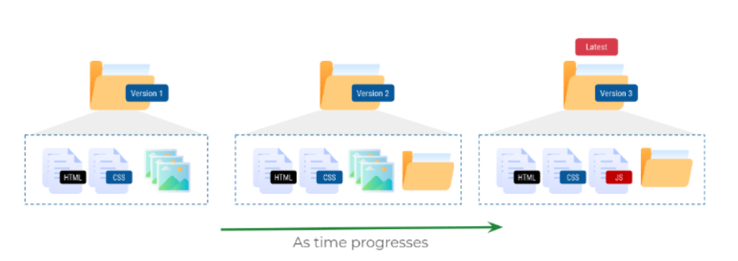
Working on a Project:
Managing Versions of a Document:
We keep making many changes when building software or even writing anything.
Advantages of Versioning:
We can quickly revert back to any of the older versions or pick up changes from an older version.
We can check how the files are modified over time.
Managing Versions of a Project:
When working on a software project, we keep making changes to existing files to add new features and fix existing bugs.

Slide 3
Collaboration:
When working on a huge project with many files which is being developed by multiple people it is hard to manually keep track of the changes.
Any small change may completely crash the project.
Versioning:
When working with multiple people, it is useful to know,
Who made changes to a given file?
When are these made changes made?
Source Code Management:
Version Control System:
Each change to project can be considered a new version of the project.
Version Control System simplifies tracking changes to the project and allow us switch back to any previous version.
There are several tools that help us manage versions of the source code of software.
Git
Subversion
Mercurial

Slide 4
Git:
Git is a free, open-source and most widely used distributed version control system.
A software used for tracking changes in any set of files.
Repository:
A Git Repository (Repo) is like a database which maintains different versions of the project files.
Snapshots:
Git allows us to take a snapshot of our project files to create versions of the project.
These versions or snapshots are referred to as commits in Git Terminology
Tracking Files:
By default, Git doesn’t track changes to a file and doesn’t maintain versions automatically.
We have to explicitly specify git to track file changes and save versions.
Selecting Specific Changes:
Most of the times we want to have a selective set of changes as part of the snapshot.
Git creates a snapshot of all the changes that are part of staging area.

Slide 5

Git’s View of Repository:
Untracked Files : The set of files whose changes are not tracked by Git.
Tracked Files : The set of files which are watched by Git for any changes.
Modified Files: These are the files which are modified after the latest snapshot.
Staged Files: The set of files which are about to be committed to create a new snapshot.
Committed Files: These are the unmodified files which are same since the latest commit.
Distributed Version Control System:
Git is a distributed version control system.
Everyone has a copy of the entire repository with the entire version history.
Git Repository:
There are several cloud-based repository hosting services which let you maintain a copy of repository
GitHub
Bitbucket
Create Account:
Create Github account by visiting https://github.com

Slide 6
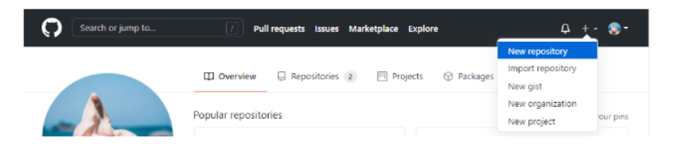
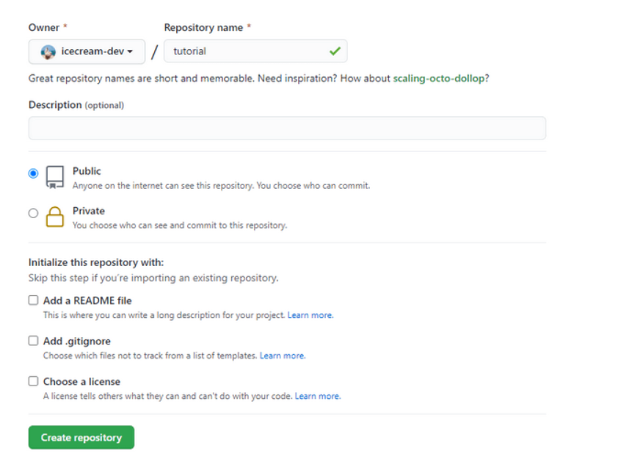
Creating a Repository:
Create a new Github repository using + button at top right corner of website.
After clicking on New repository button you can see screen similar to below.

Slide 7
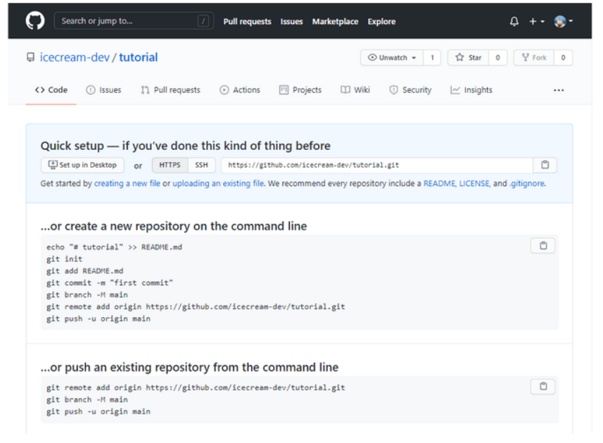
After creating github repository you can be able to see screen similar to below.

Slide 8
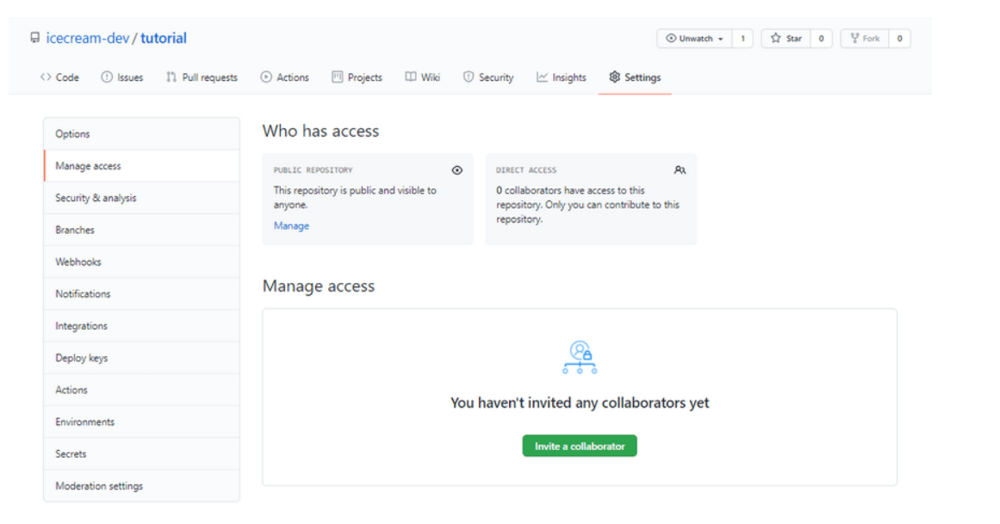
Sharing Repository:
We can share the repository with other users on GitHub to collaborate.
You can invite collaborators by visiting settings > Manage access and clicking on Invite a collaborator.

Slide 9
Git Client:
Installing git in your system to manage & work with Git Repositories.
In Linux :
In MAC :
Setting Author Info:
Configure who gets credit for the changes made from your device by setting the author details from your terminal.

Slide 10

Command Line Coloring For Git:
To set automatic command line coloring for Git for easy reviewing.
Viewing Git Client Configuration:
You can check your current git client’s configuration with git config –l
Cloning Repository:
git clone creates a copy of remote repository on your computer.
Cloning a repository downloads all versions of the files that ever existed to your computer.
The .git/ folder present in the repository contains all these versions and information required for version control.

Slide 11
Displaying the Remote:
Lists the details of the configured remote repo.
Initializing a Git Repository:
Apart from cloning a repo, you can also initialize a git repo in an existing folder.
Useful when you want to convert an existing, unversioned project to a Git repository or initialize a new, empty repository.
git init initializes an empty git repository in the working directory.

Slide 12
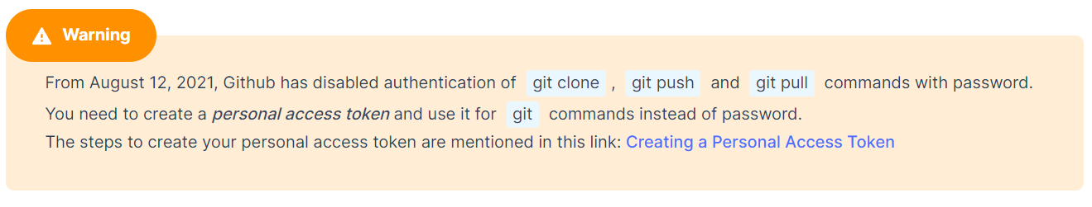
Adding Remote Repository:
git remote add can be used to configure a remote repository to the local repository.

Slide 13
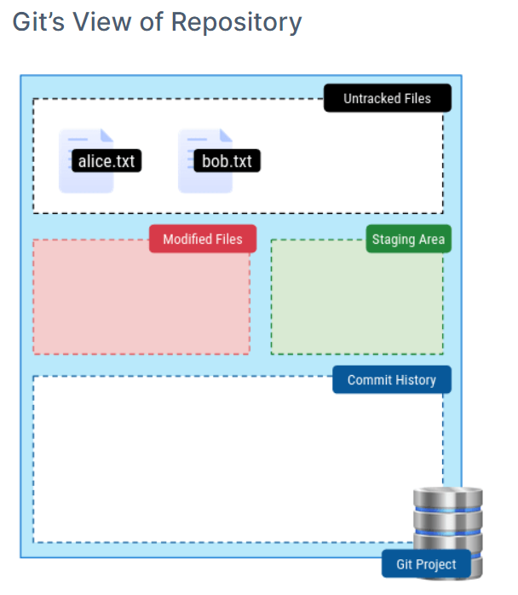
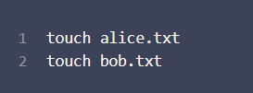
Staging Area & Commits
Creating a Commit:
Working Directory:
We shall refer the project folder as Working Directory.
Let’s add two files alice.txt and bob.txt to our working directory.

Slide 14
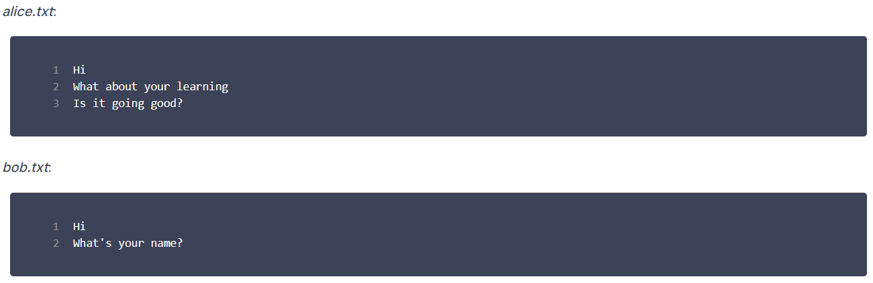
Inspecting a Repository:
Git tracks the changes in the working directory.
git status shows the changes in the working directory
Making Changes:
Added some content to alice.txt and bob.txt files.

Slide 15
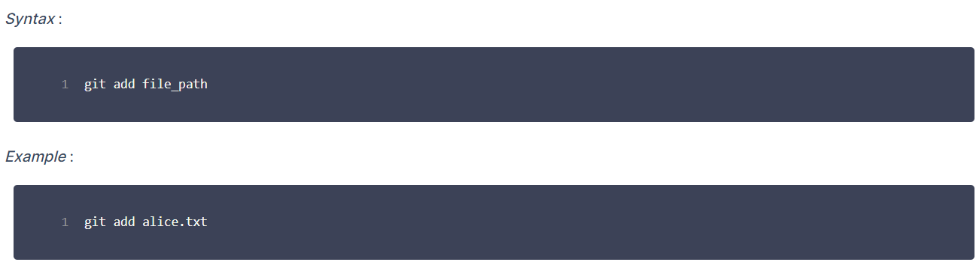
Steps in Creating a Commit:
Add changes to the staging area.
Creating a commit with changes in staging area.
Step 1: Adding Changes To Staging Area
git add adds the changes to the staging area.

Slide 16
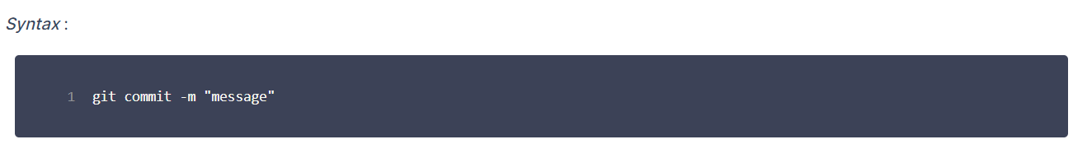
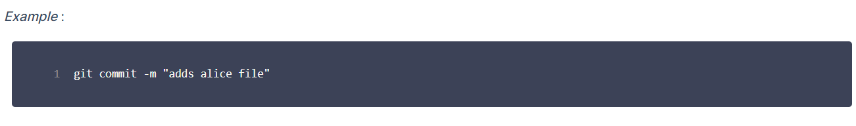
Step 2: Committing Changes
commit is a snapshot of the project's currently staged changes.
Here message provide useful information about what has changed and why.

Slide 17
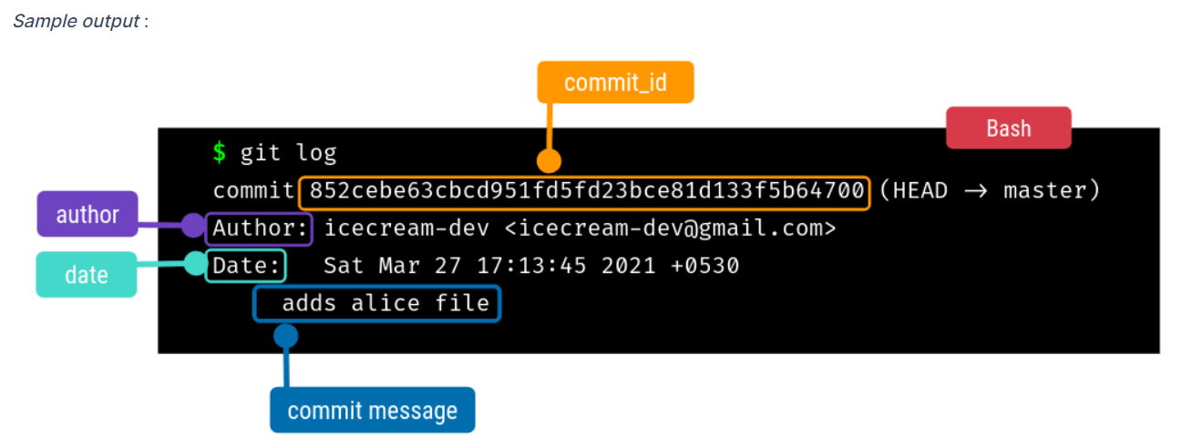
Listing all commits:
git log lists all commits.
Here HEAD refers to the current commit.

Slide 18
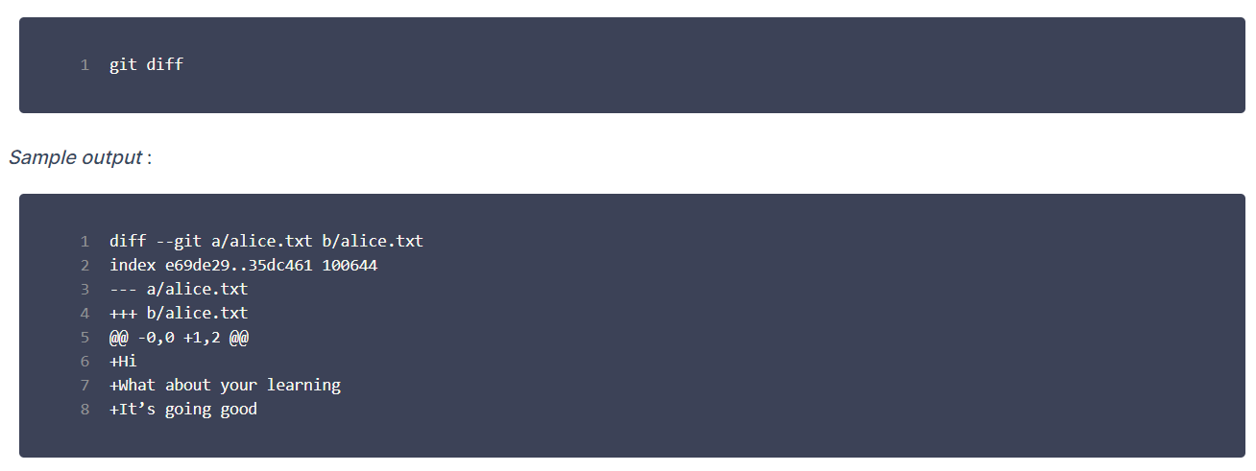
Commit Id:
Commit IDs are unique strings(hashes) that are created whenever a new commit is recorded.
8f00aaa0248bcdc38a8d8ba6267167a0478f5a63 is commit id in above Example.
Unstaged Changes:
git diff shows the unstaged changes.
Uncommitted Changes:
git diff --staged shows the staged and uncommitted changes.

Slide 19
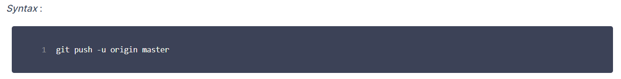
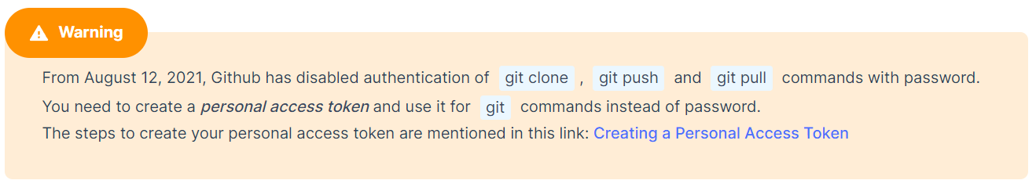
Working with Remote Repository:
Pushing Commits:
git push command is used to publish new commits from local to a remote repository.
You can also edit file and commit changes through github Website

Slide 20
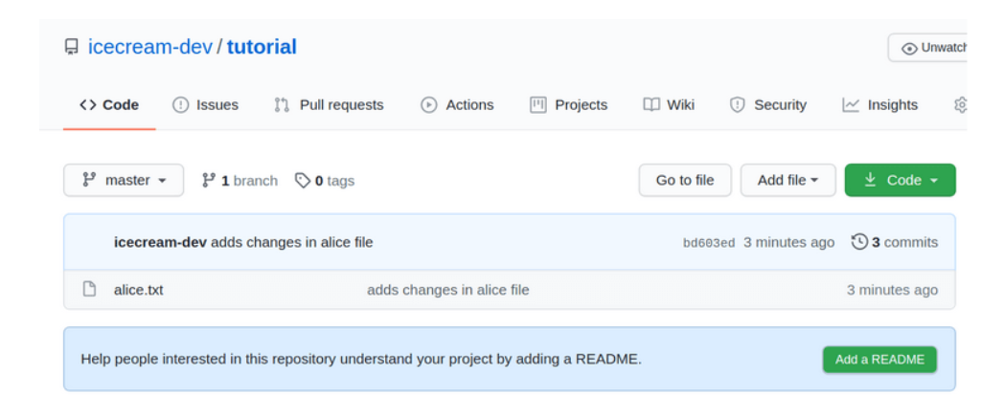
Editing File:
Click on the file you want to edit.

Slide 21
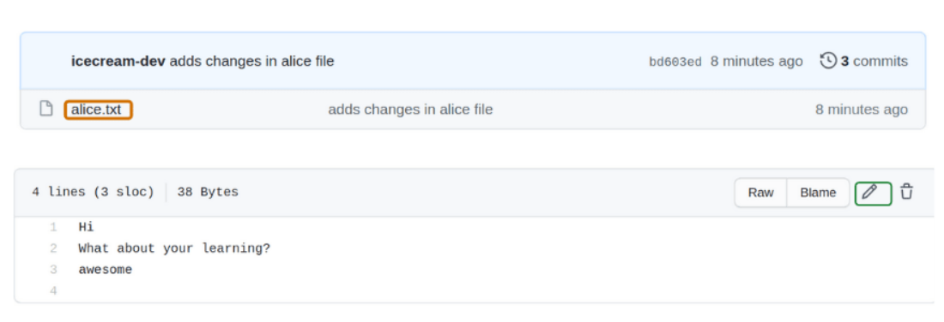
Click on pencil icon to open editor :

Slide 22
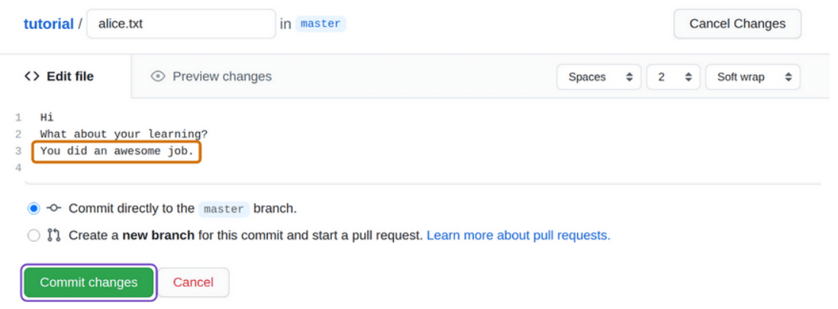
Commit Changes:
To commit changes click on Commit changes.

Slide 23
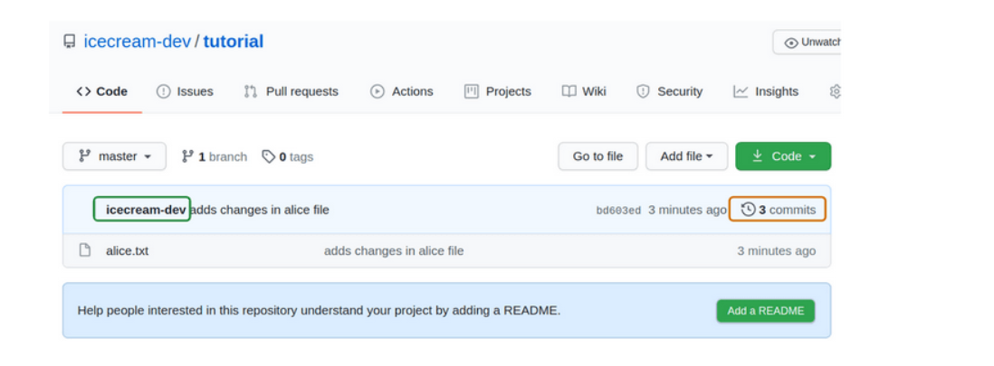
Get Commit Link:
To share specific link of a commit, follow below steps:
Click on commits to view all commits.

Slide 24
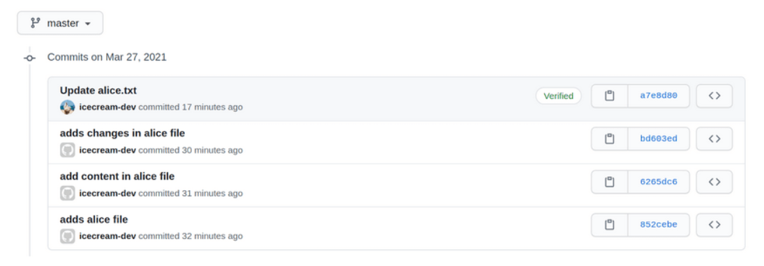
Click on commit id of commit you want to share.

Slide 25
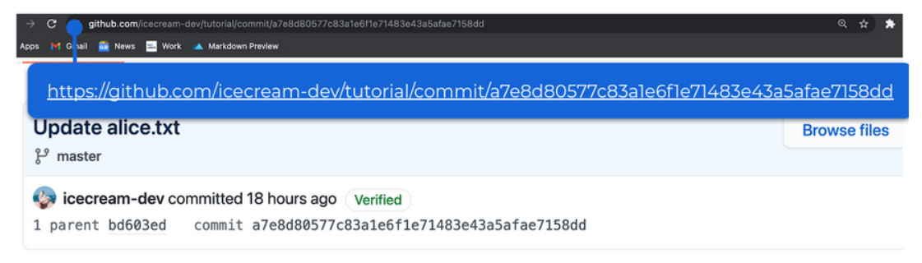
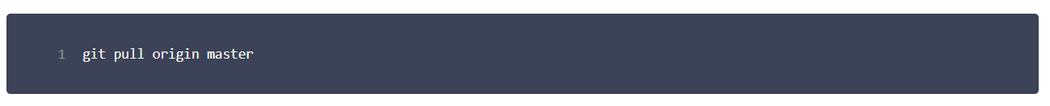
Copy the url and share.
Pull Commits:
git pull is used to pull latest commits from a remote repository to your local repository.

